Slide 1


ncca RenderFarm Tool
Maya: VRay
Constantinos Glynos
Gordon Dunn

Slide 2
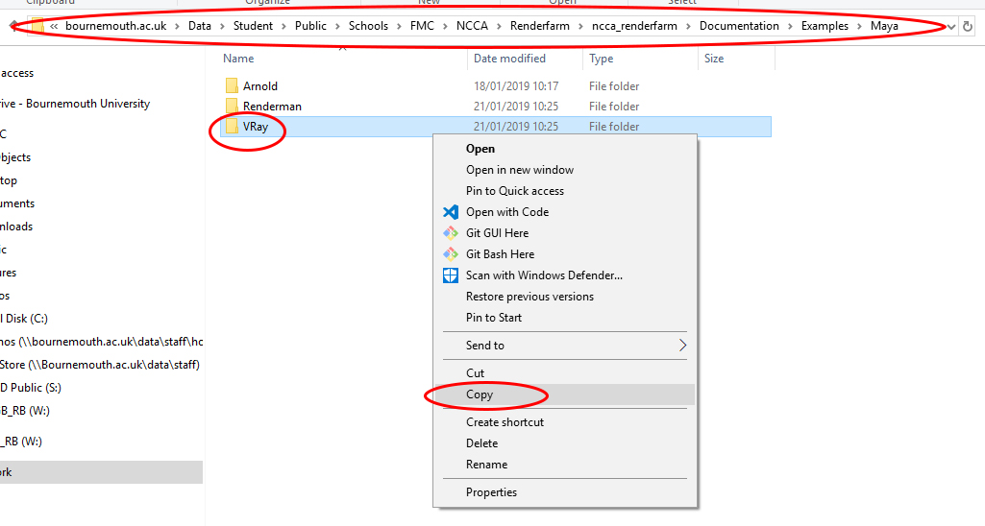
Copy the example scene
The VRay example project directory is at
\\bournemouth.ac.uk\Data\Student\Public\Schools\FMC\NCCA\Renderfarm\ncca_renderfarm\Documentation\Examples\Maya\
Copy and Paste the project directory to your Desktop or to the D: drive
Open Maya

Slide 3
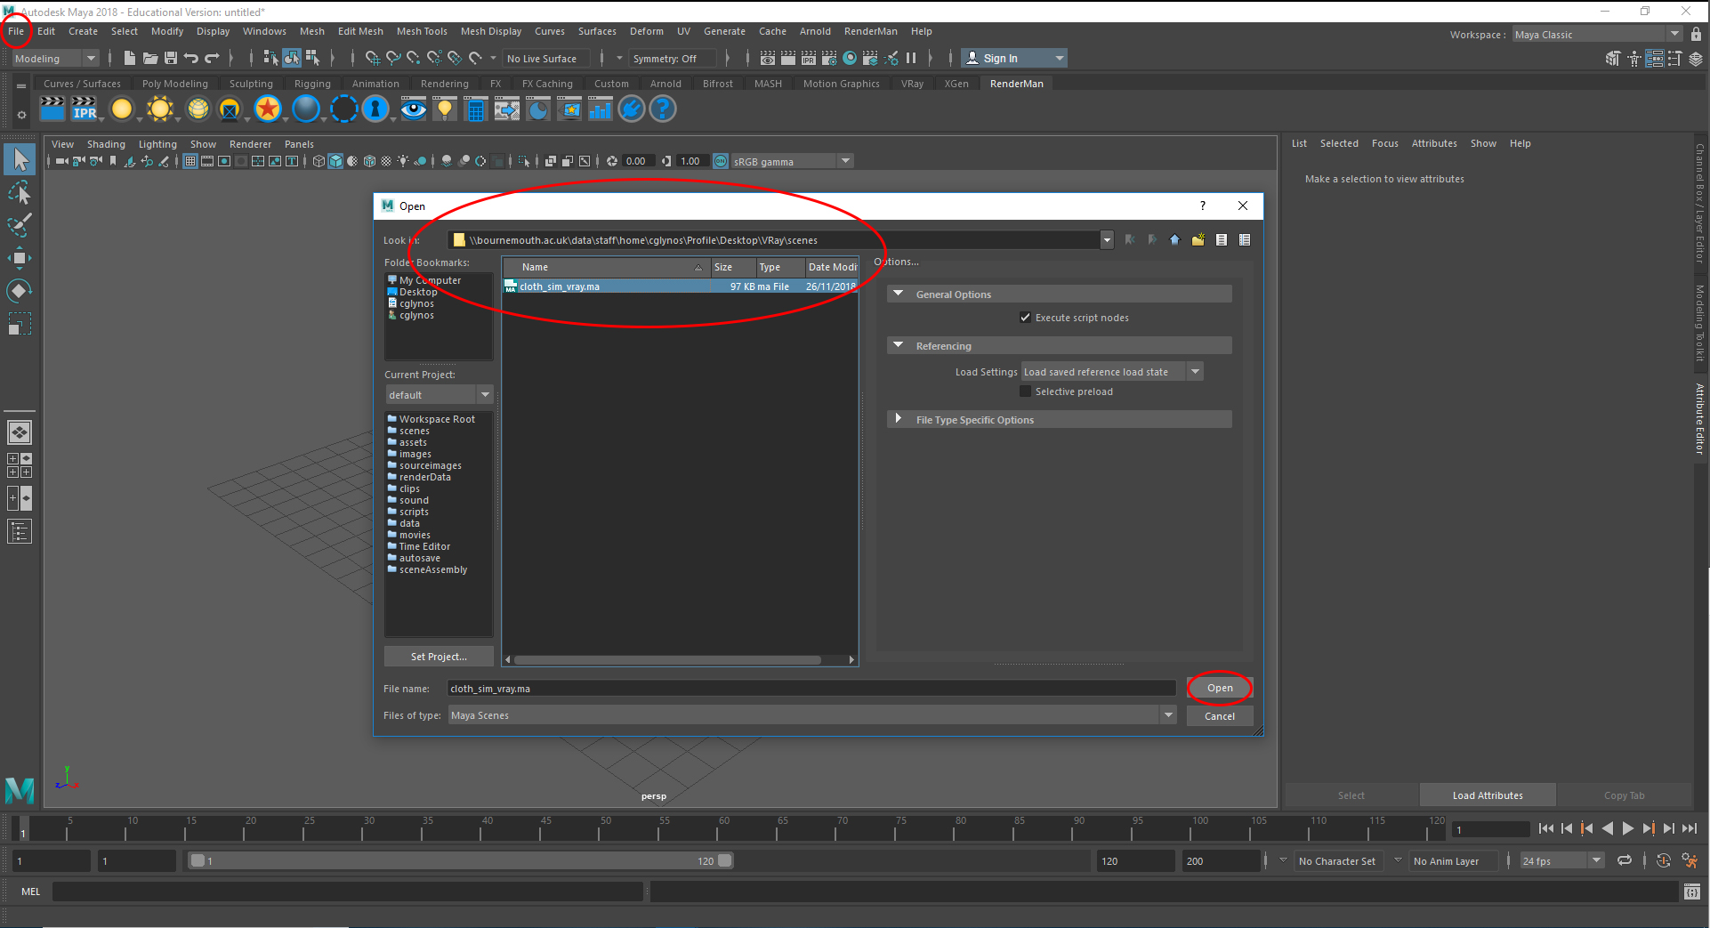
Open the example scene
File -> Open -> cloth_sim_vray.ma

Slide 4
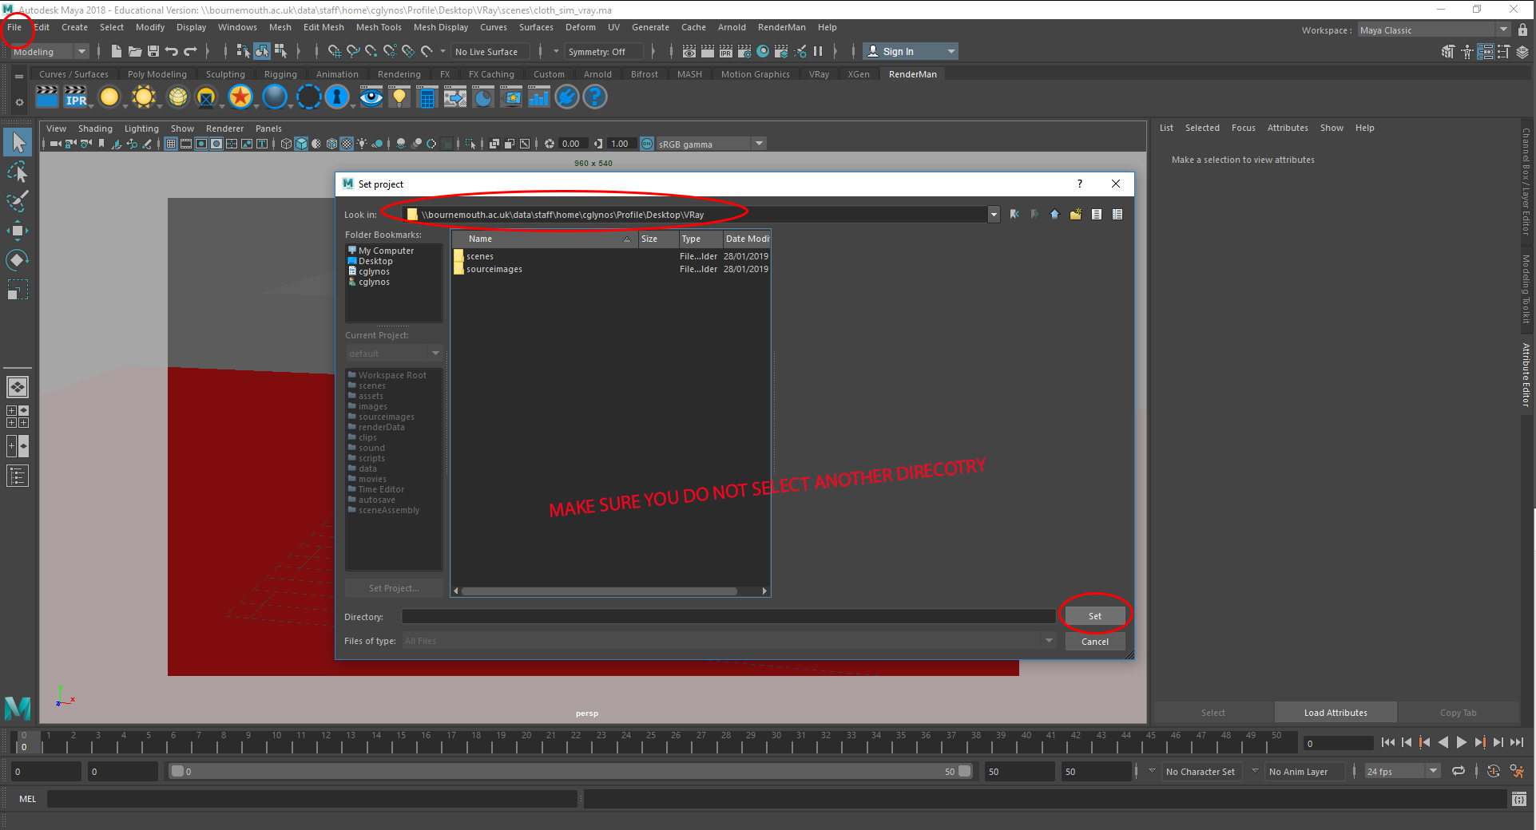
Set project directory
File -> Set Project...
Select the directory which is parent to all the project data files and folders.
Make sure you do not select another directory inside the parent directory
Click Set
Select Create default workspace

Slide 5
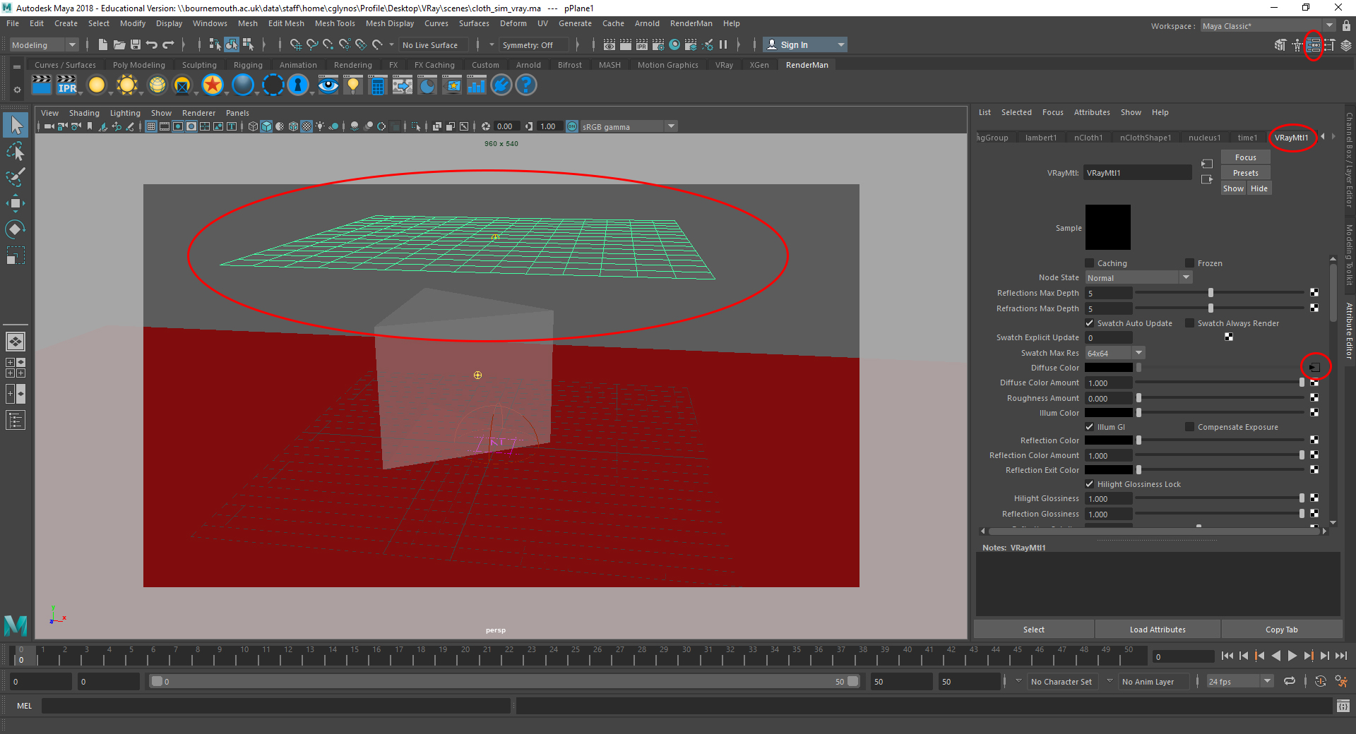
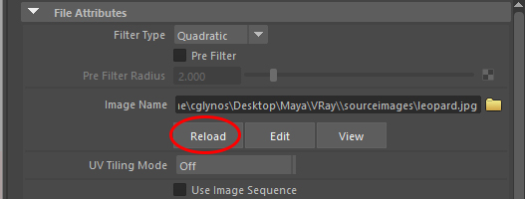
Update the textures
Select the pPlane1 mesh
Go to the Attribute Editor -> VRayMtl1
Click on the Diffuse colour option box
Under the Image Name text box, click on Reload.
After hitting Reload, that long path should now say:
sourceimages\leopard.jpg
Do the same for the rest of the objects if they have any textures

Slide 6
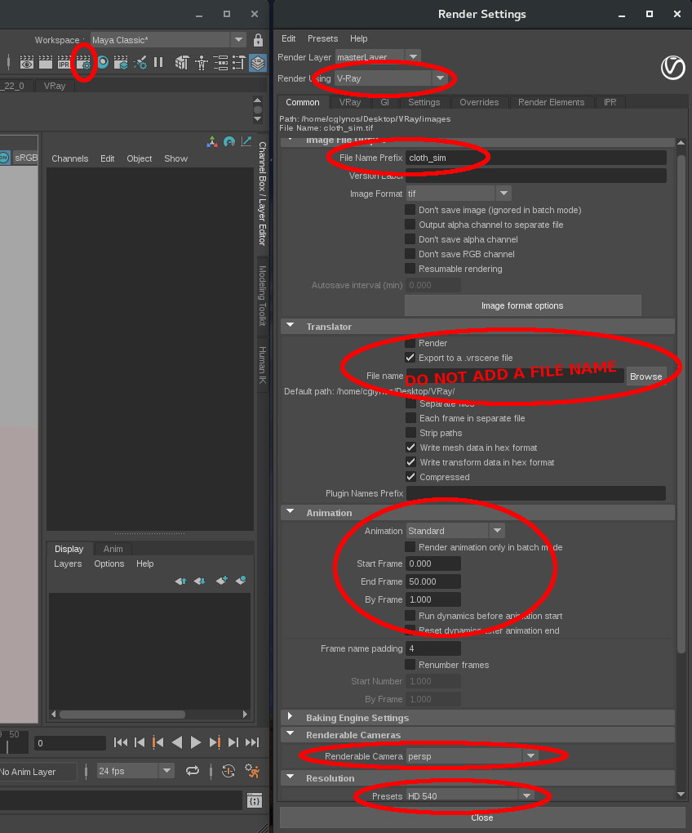
Check the render settings
Check that your render settings are correct:
Select the VRay renderer
Make sure you have a name for the output renders
Tick on Export to a .vrscene file
Do not give a file name for the .vrscene
Check the format and frame padding
Make sure your animation frames are correct
Select the camera to render from
Set the correct resolution

Slide 7
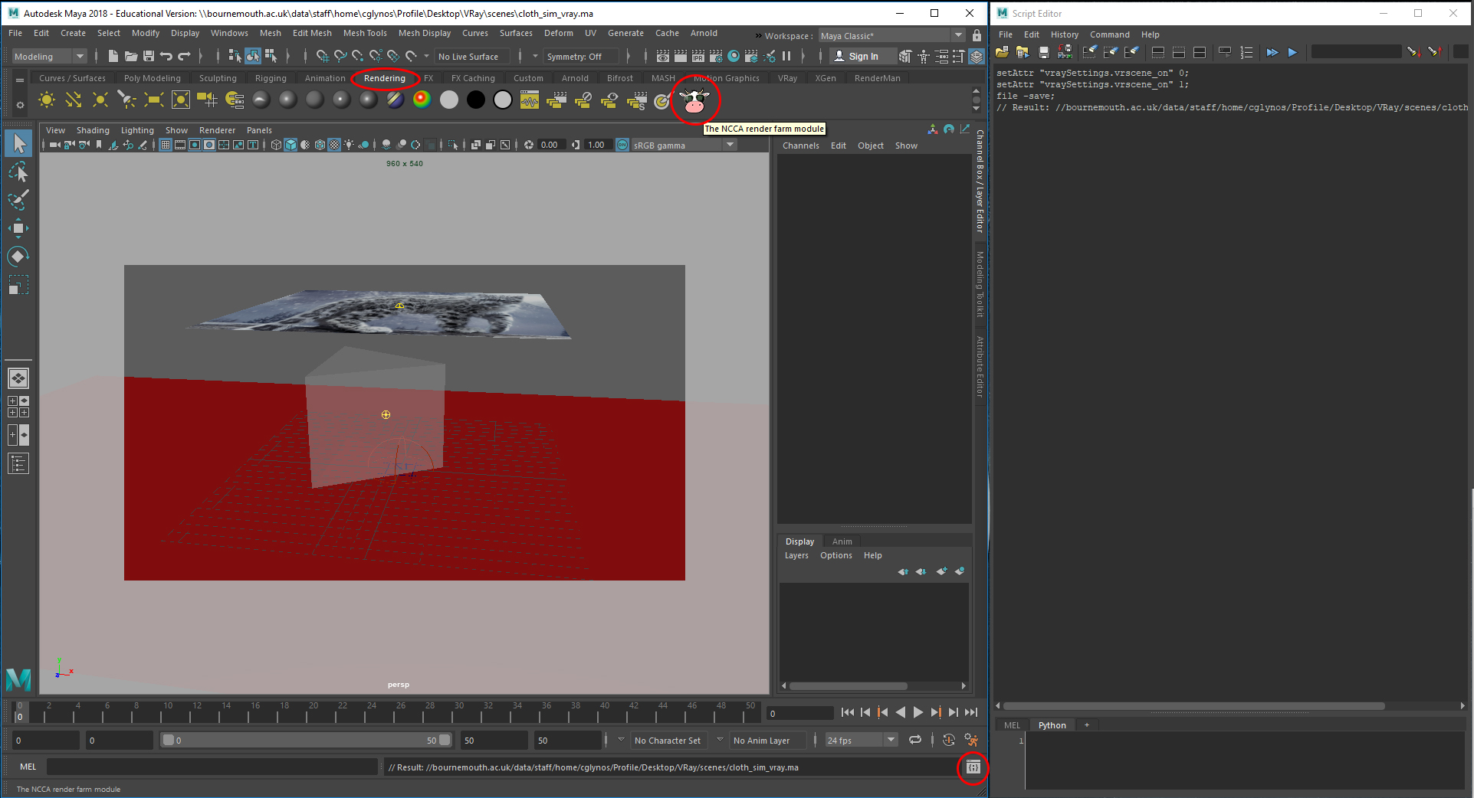
Let's render
Press Ctrl + S to save the scene
Open the Script Editor for debugging information
Go to the rendering shelf
Hit the cow!

Slide 8
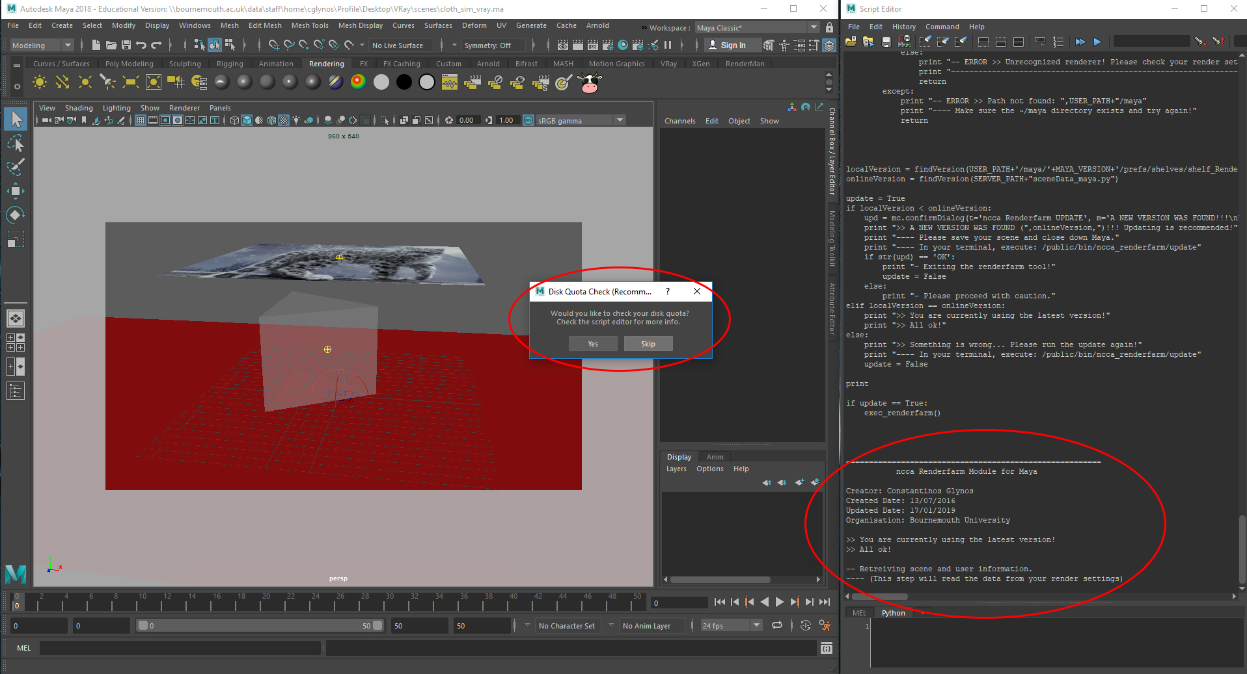
Using the tool
Check your local disk space (quota), or skip if not needed.
Check the script editor for any warnings about the version of the tool you are using.

Slide 9
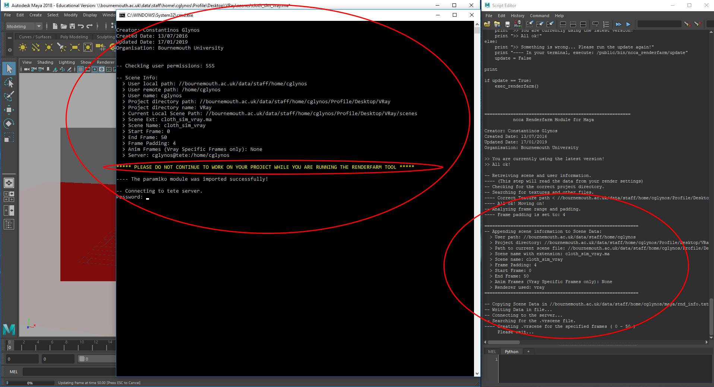
Using the tool
The tool will generate your .vrscene. If one exists, already it will ask you if you want it to be replaced. Otherwise, it will use the old .vrscene for your renders.
A new cmd prompt will appear which links to the renderfarm.
[FIRST TIME] The tool will search for the necessary libraries and install the missing ones. This might take a while.
Check the data passed on to the renderfarm by reading the script editor and the cmd. If not correct, just close the cmd prompt to cancel the process.
DO NOT USE MAYA OR CONTINUE TO WORK ON YOUR SCENE WHILE YOU SUBMIT A JOB TO THE RENDERFARM.
Enter your password to continue.

Slide 10
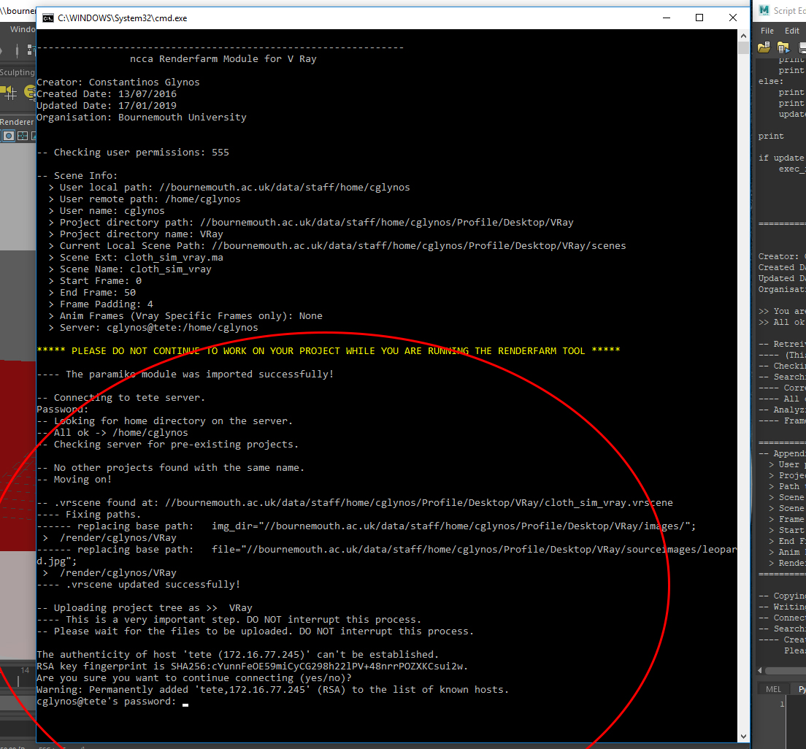
Using the tool
The tool will check if you have any existing directories with the same name on the server and prompt for action (replace or rename).
It will also update your .vrscene file to match the paths of the renderfarm.
Enter your password again to upload your project directory onto the tete server.

Slide 11
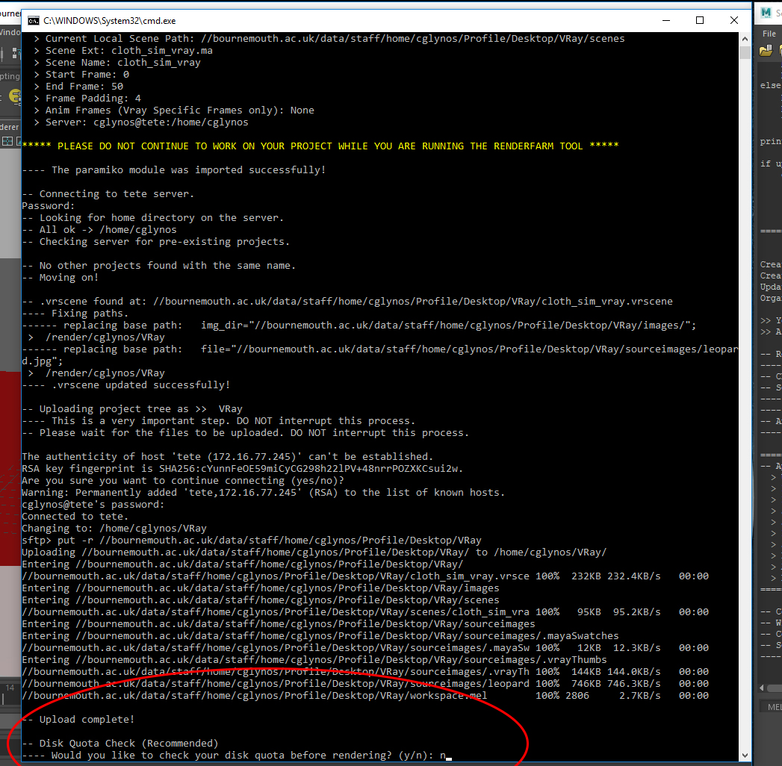
Using the tool
Once the files are uploaded, the tool will prompt for a quota check on the server.
If you do not have enough disk space (quota) available on the server, your renders will not be saved anywhere.
Skip online quota check iff you are sure you have enough space available.

Slide 12
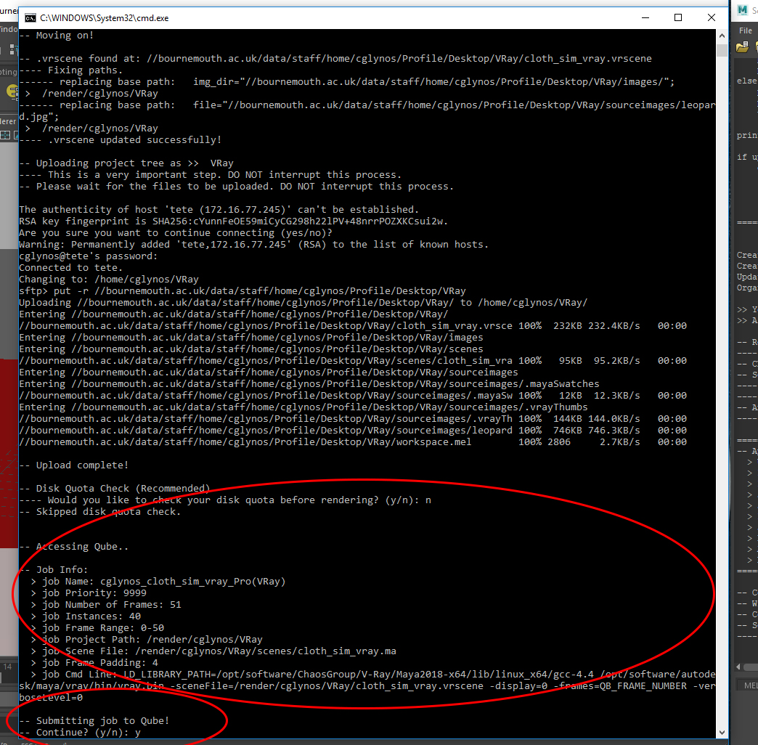
Using the tool
The output images directory is set from within your .vrscene and project directory settings.
Check the Job info data before submitting the job to Qube.
Type y and Enter to continue.

Slide 13
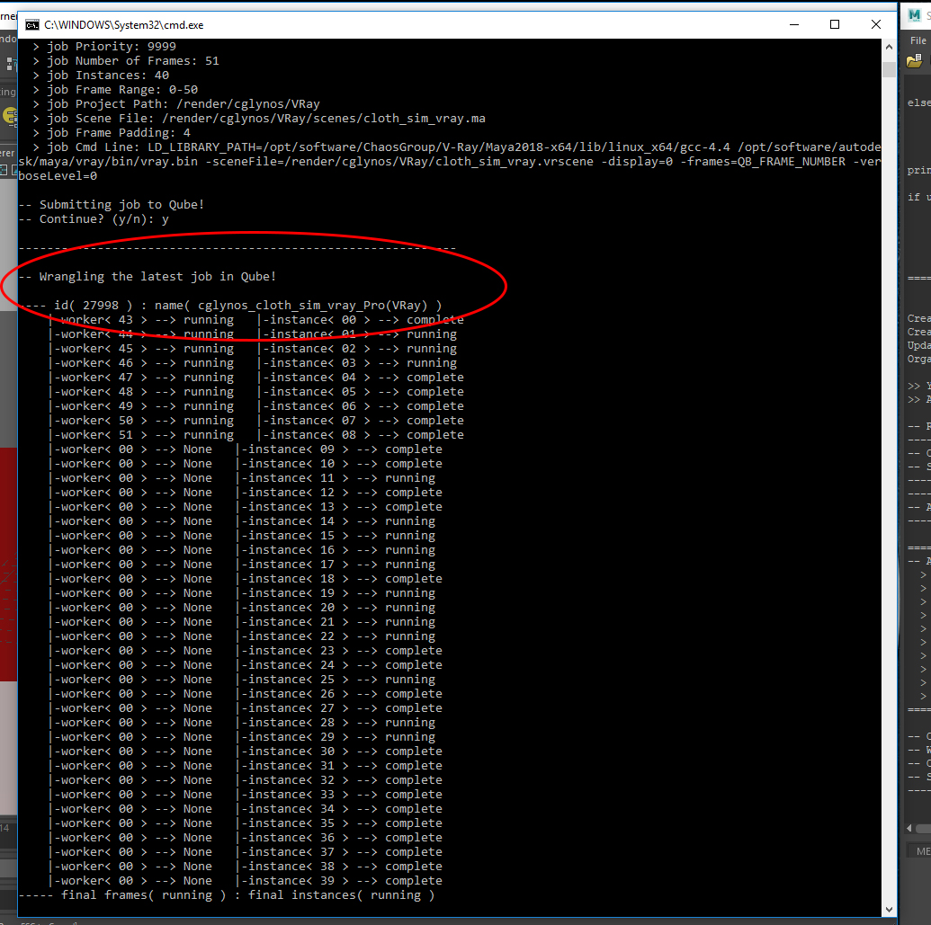
Using the tool
Wrangle your renders from the cmd prompt.
At this point you can safely close the cmd prompt and wrangle your renders from Qube. But it's advised that you leave the cmd open.
Now we wait for it to finish.
You can now continue to work on your scene.

Slide 14
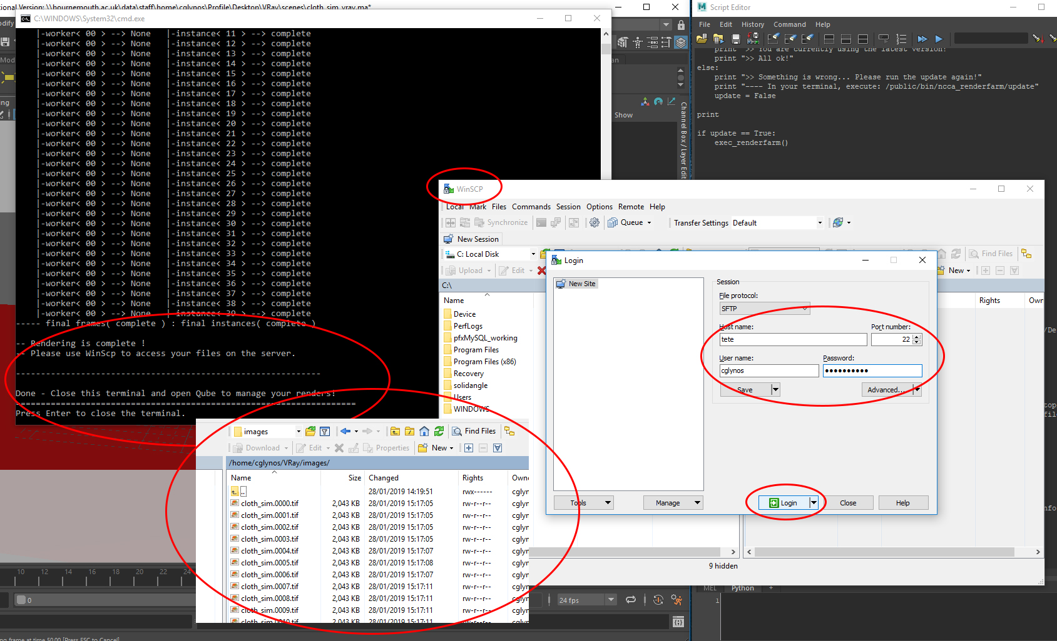
Finishing off
Once the renders are complete, the tool will prompt you to open WinSCP to access your renders on the server.
Use tete as the host name and then log in using your student credentials.
You can now close the cmd by pressing Enter again or by using the close button.

